Slide 1
WELCOME TO HDSC ’22 CAPSTONE PROJECT
PRESENTATION
BY
TEAM PROPHET
China Scholarship
(Economy & Education)
Notes:
Project group PP22_C628

Slide 2
INTRODUCTION
TOPIC: China Scholarship Data – May 2019
PROJECT DESCRIPTION: The dataset contains information about the scholarship program in China as of May 2019
AIM OF PROJECT :Many secured scholarships, but they end up losing them. They do not know the total expenses those scholarships demand. The goal of this project by team Prophets is to help predict the Total Expenses for a scholarship using this dataset.
DATA SET: Source[kaggle]
China_scholarship.xls
To follow along, the project was deployed on Heroku and the code can be found on GitHub.

Slide 3
AGENDA
Every machine learning project follows a workflow and phases, depending on the project specifications. To achieve this result. The phases include:
Data collection
Exploratory Data Analysis
Data Preparation(Feature Engineering)
Modeling
Deployment.
Deployment
Modelling
Data Preparation
Data Analysis
Data Collection
Introduction

Slide 4
Data Collection
The data used was collected through web-scraping, a process of extracting data from website https://www.cucas.edu.cn/china_scholarships.
The dataset contains information about the scholarship programs in China as of May 2019. The cleaned data can be easily accessed on Kaggle.

Slide 5
Exploratory Data Analysis
This phase involves processes of understanding the data using visualizations and statistical tools. It is the process of digging into the data to get intuitions that will be needed in the feature engineering phase. Some of the EDA we carried out include checking for missing values, distribution of the features, multicollinearity of variables and performing univariate and bivariate analysis.
From the analysis, the dataset has 3576 observations with no duplicates and 16 columns.
The dataset contains 7 categorical and 9 Numerical data types columns.
The Tuition Covered and Original Tuition Fee columns have 123 null values each.
Original Tuition Fee, Accommodation To Pay are highly positively correlated while Living Expense Covered and Expense To Pay are highly negatively correlated as shown in the heatmap diagram.

Slide 6
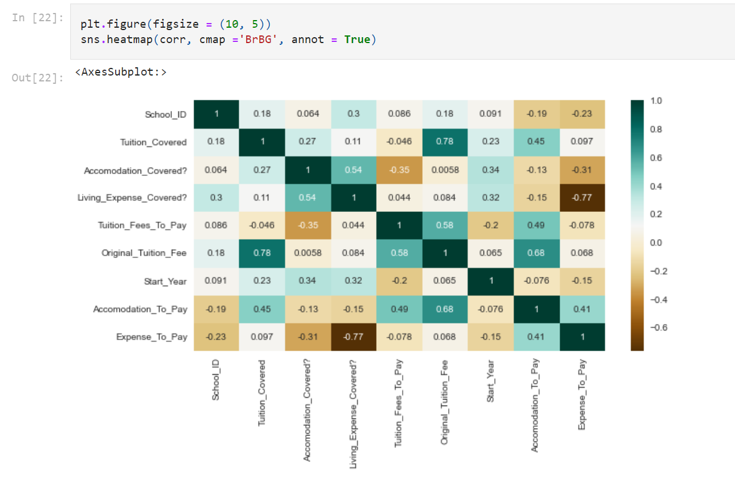
Multicollinearity

Slide 7
Univariate Analysis
Zhejiang Normal University has the highest frequency.
Most Universities give scholarships at the Master's level followed by the Bachelor's level.
The most common language is Chinese.
The start month of the scholarship is usually September while the Accommodation Duration and Expense Duration is usually monthly.
About 2500 Scholarships do not cover for accommodation(Accommodation Covered?) and living expense(Living Expense Covered?)
Computer Science and Technology is the highest major for scholarship

Slide 8
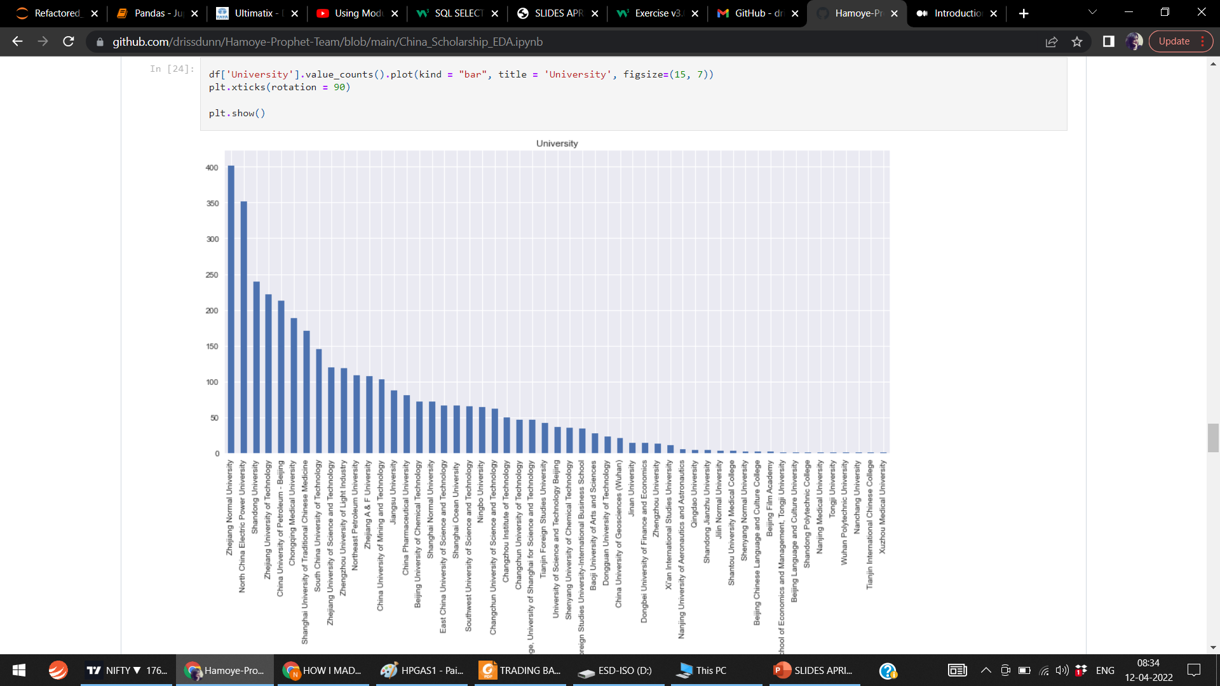
This dataset contains 53 universities in 38 districts and the Zhejiang Normal University has the highest frequency.

Slide 9
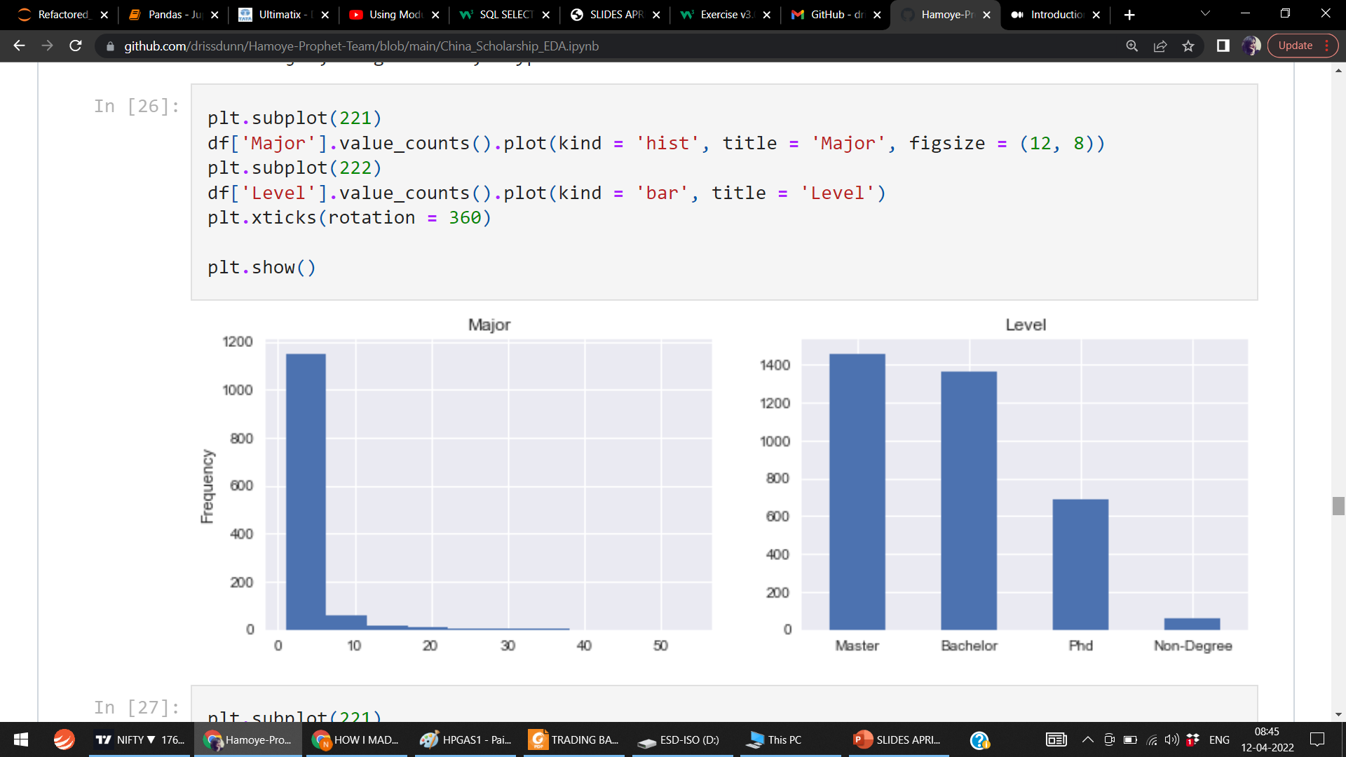
Most Universities give scholarships at the Master's level followed by the Bachelor's level and, Computer Science and Technology is the highest major for scholarships granted.

Slide 10
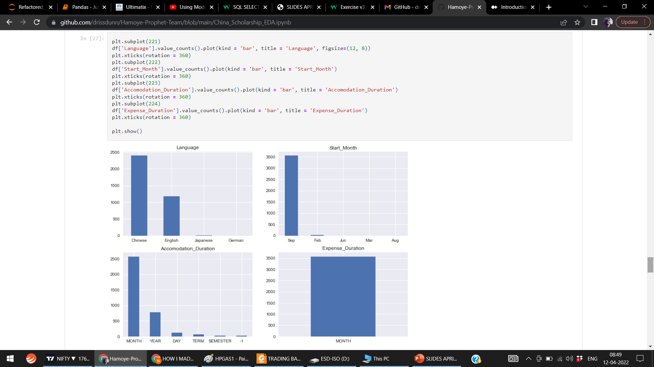

Slide 11
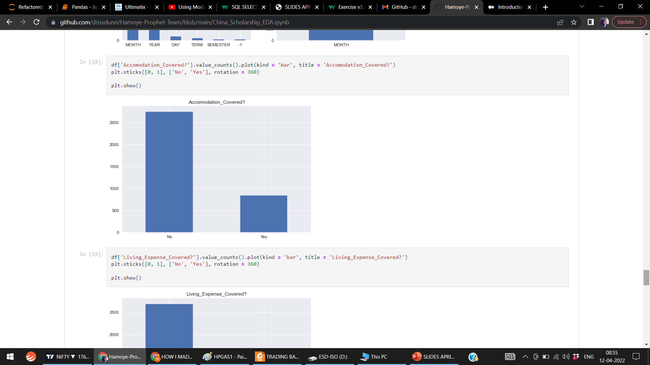
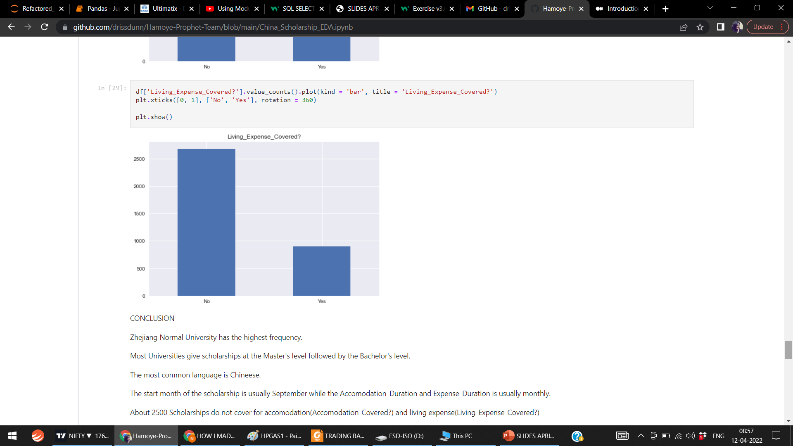

Slide 12
Bivariate analysis
Bivariate analysis was conducted to determine the relationship between two variables. To determine linear relationships between Original Tuition Fee, Tuition Fees To Pay and Tuition Covered. barplot , scaterplot function were used.
CONCLUSION
The Tuition Covered increases as the Original Tuition Fee increases.
Most Scholarships do not cover the Expense To Pay.
Most scholarships do no cover the Accommodation To Pay.

Slide 13
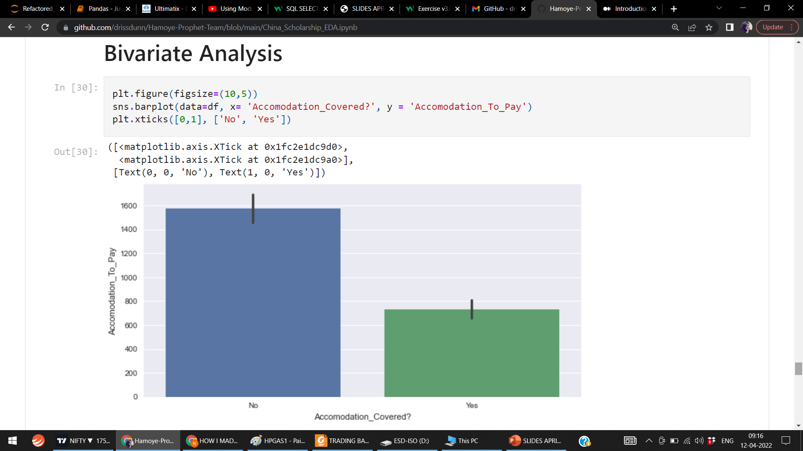
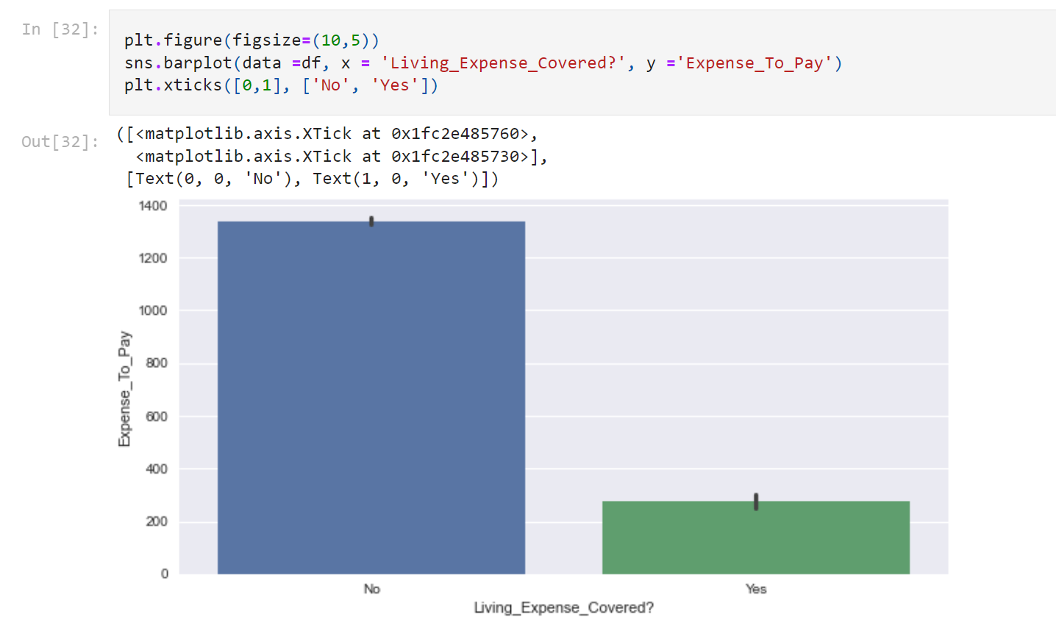
The most common language is Chinese, which is expected as it is a Chinese dataset. The start month of the scholarship is usually September and the Accommodation Duration and Expense Duration are usually monthly.
The majority of the scholarships do not cover accommodation(Accommodation Covered) and living expenses (Living Expense Covered).
The Tuition Fees To Pay increases as Original Tuition Fee and Tuition Covered increase.

Slide 14
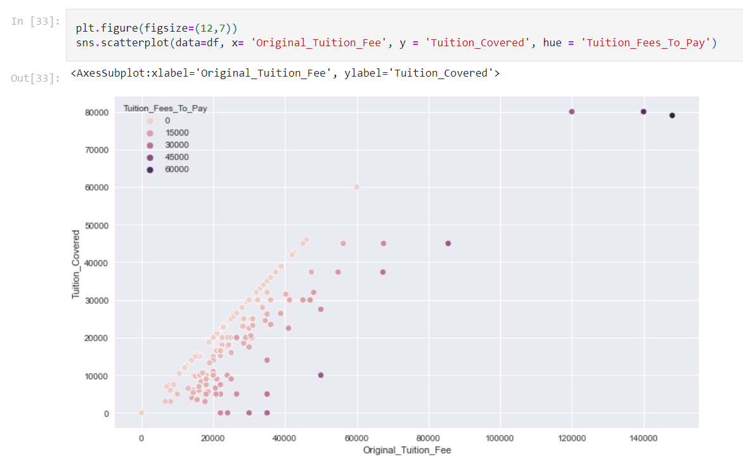
Tuition Fees To Pay increases as Original Tuition Fee and Tuition Covered increases.

Slide 15
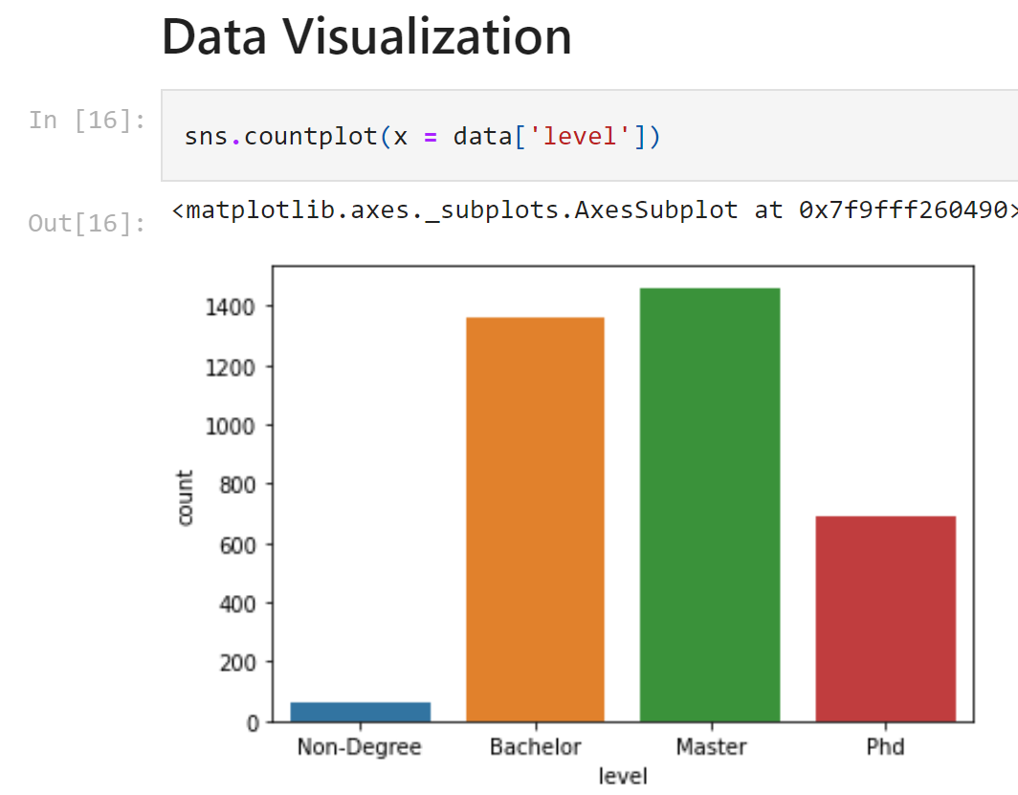
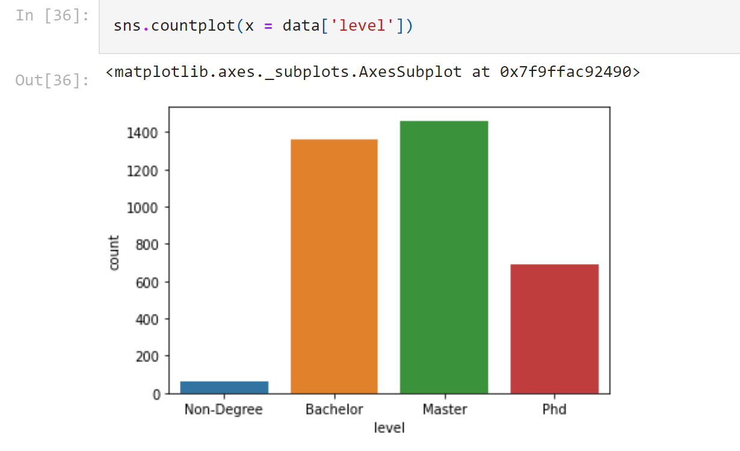
← More people applied for Masrter Level

Slide 16
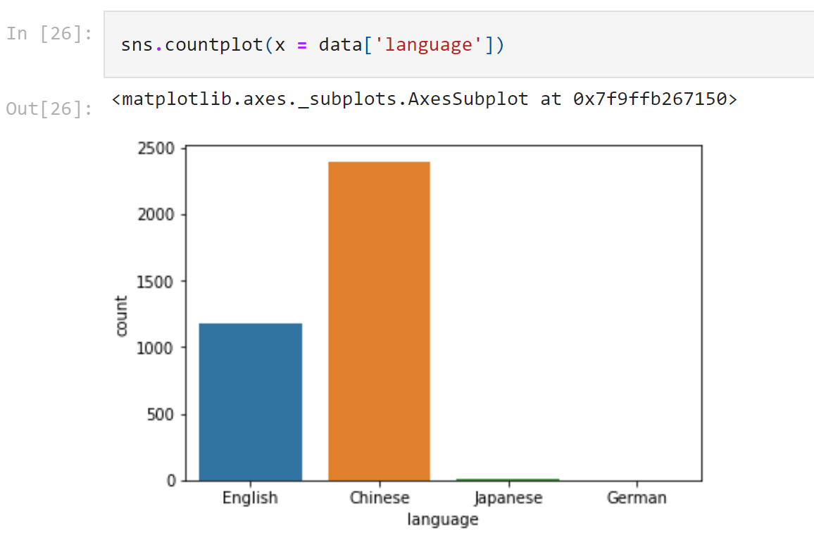
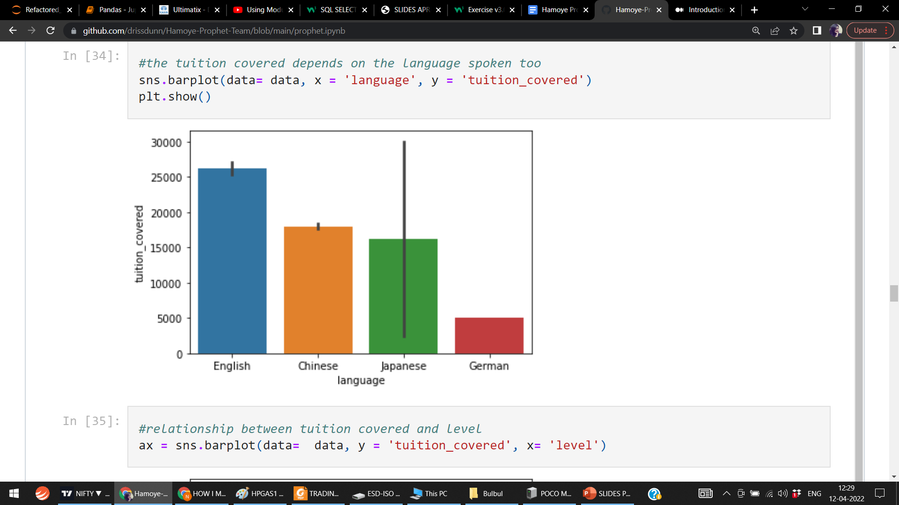

Slide 17
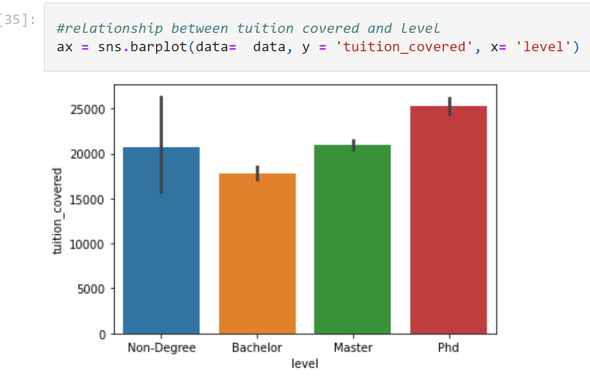
In the charts above, its shows that
More people speak Chineese
The English speaking schools cover more tuition fees than the schools who speak other languages.
Lastly, the tuition covered for Ph.d students is more than other levels although most of the scholarships offered are for bachelors and masters level.

Slide 18
DATA PREPARATION(Feature Engineering)
This phase makes the data ready for modeling. It requires a numeric representation of raw data to be fitted to models. It is also a process of generating more features using domain knowledge to improve the performance of the model.
After much deliberation and consideration, only 8 features were used for modeling.
Numerical features missing values were filled using Mean with SimpleImputer function and scaled with MinMaxScaler().
Categorical features were encoded using OrdinalEncoder and also scaled.

Slide 19
MODELING
Now the data is well prepared. This phase is the Supervised learning stage where an algorithm learns from data and develops weights and biases that will be used to predict the unseen data.
Random Forest and Xgoost, popular tree-based models with track records of good performance on data and their simplicity were the models used.
Xgboost performed better after Hyperparameter tuning with an R² score of 0.933. The goal of hyperparameter tuning is to get optimal parameters that will produce the best result and this was done using a package called Optuna.

Slide 20
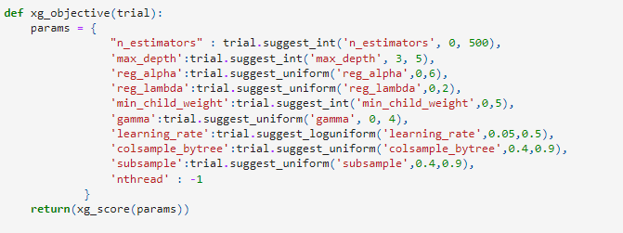
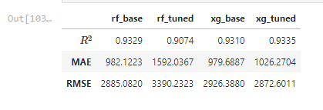
Other metrics were used to check the performance of the models, as shown in the table below.

Slide 21
DEPLOYMENT
This is the final phase of a machine learning project, although it is an iterative process. The goal is to implement and make available the model to the end-user.
The team deployed the model as a WebApp:
with Heroku, a platform as a service (PaaS) that enables developers to build, run, and operate applications entirely in the cloud.
and the Web page was designed using Html and CSS.
Here is the link(https://predict-scholarship-fee-app.herokuapp.com/) to the WebApp.

Slide 22
CONCLUSION
The team has been able to help scholars predict the Total Expenses that they should budget for in the scholarships they have been granted.
The performance of the model can also be improved with more Hyperparameter tuning and feature engineering. Also, with more data, we can extend the solution to the whole world and help more scholars.

Slide 23
THANK YOU FOR LISTENING !

